Slide 1
Lab 5: OpenACC

Slide 2
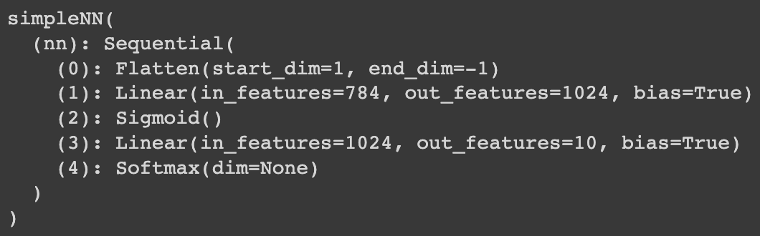
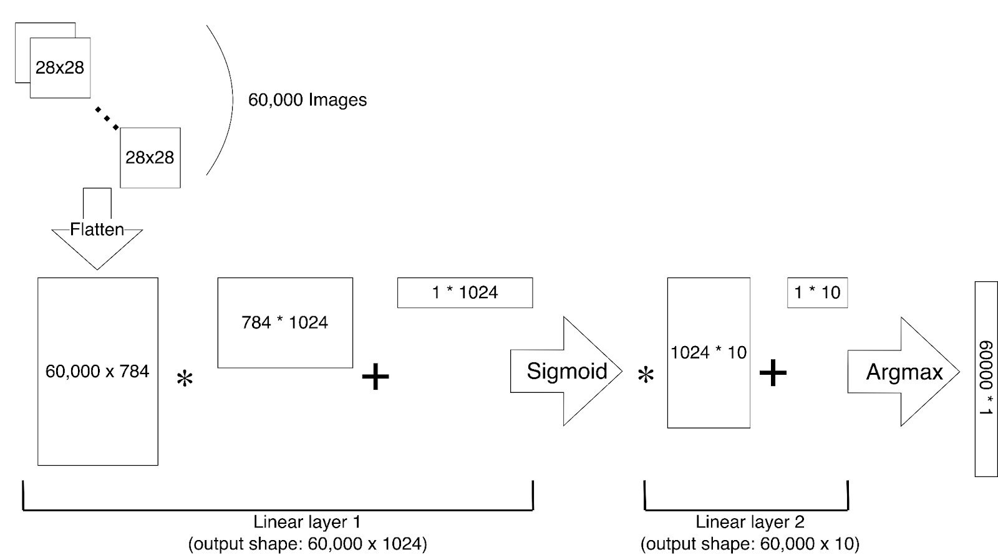
DNN Model
2 fully-connected layers
Recognize handwritten digits (0~9)
Input dimension: 28x28
Batch size: 60,000

Slide 3
DNN Model
3 types of calculation:
Single Layer (y = aX + b)
Sigmoid
Argmax

Slide 4
Task
The sequential code requires about 30~40 seconds
Please parallelize the code using OpenACC (GPU).

Slide 5
Template Files
CPU sequential code: lab5.cpp
Pre-trained model weights
Makefile
Files are located at: /home/pp23/share/lab5/
Only my_nn() and functions invoked inside my_nn() can be modified.

Slide 6
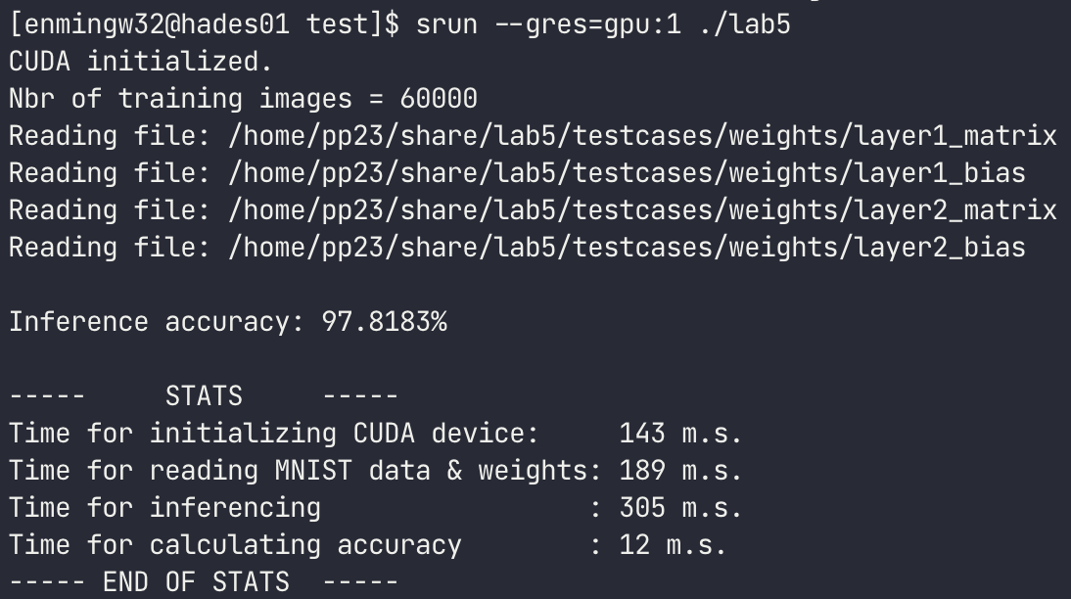
Compile & Execute
Load module (NVIDIA HPC SDK): module load nvhpc
Compile: make
Execute: srun --gres=gpu:1 ./lab5
Judge: lab5-judge
The expected inference accuracy is 97.8183%

Slide 7
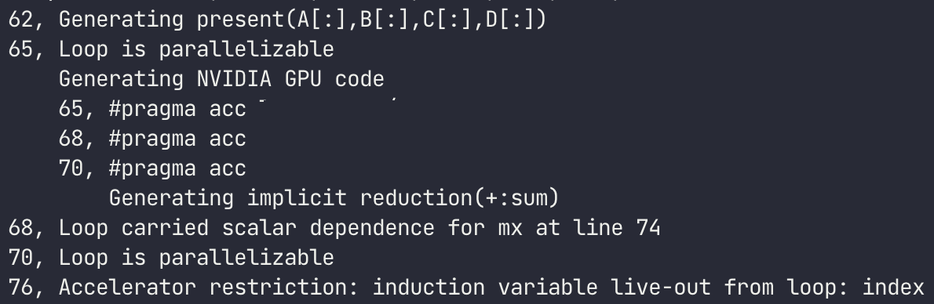
Compilation details
nvc++ will print the loops that is compiled successfully for running on GPU.
The file extension should be .cpp, do not modify it to .cu. Otherwise, nvc++ would not compile it.

